Slide 1
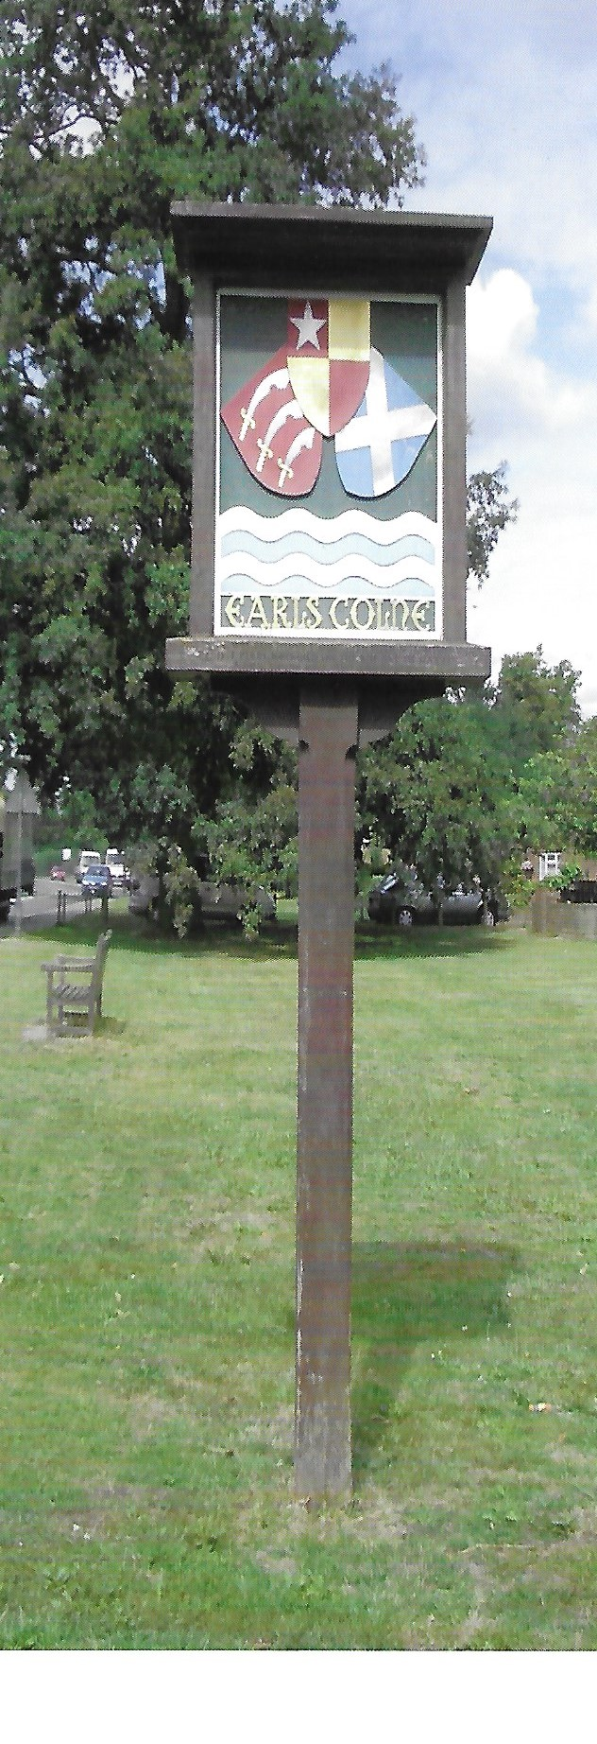

Earls Colne Neighbourhood Plan
Proposals For discussion at the Parish Council Meeting 19th December 2018

Slide 2
Summary of Proposals
Agree to move forward with the Neighbourhood plan based on the relatively successful outcome of the campaign to engage volunteers
Formalise a Parish Council Neighbourhood Plan Sub Committee and arrange to conduct a review of the list of volunteers who expressed an interest in being part of the Steering Group and then have initial discussions with them on an individual basis.
Form the Neighbourhood Plan Steering Group and arrange a kick off meeting in early 2019.
It is suggested that the leaders of each of the five Task Groups are members of the Steering Group (for ease of ongoing management and communication)
It is considered unnecessary to apply for funding for the current financial year (ending April 2019)

Slide 3
Parish Council Neighbourhood Plan Sub Committee
Members:
Tony Calton
Hugh Street
Margaret Barrett
Mort Smith
Possibly consider a further member in light of the current situation with Mort?
Reminder of Main Responsibilities
Qualifying body responsible for the production of the Neighbourhood Plan.
Financial control, and ensuring adherence to statutory requirements
Made up of 3 or 4 members of the Parish Council

Slide 4
Neighbourhood Plan – Steering Group
Potential Members:
Name | Possible Leaders of Task Groups (as indicated by each individual volunteer)
 | Housing | Environment | Economy | Community Facilities | Infrastructure
Tony Calton
Jayne Meleschko |  | X |  | X
Janet Baldwin | X | X | X | X | X
Sheila Boyce
Robert Cook | X |  |  |  | X
Sharon / Paul Copsey | X | X |  | X | X
Donna Goodchild | X | X
Catherine Hayes | X | X | X | X
Denise Siddall | X | X | X |  | X
Tim / Nicki Spelling |  | X |  |  | X
Reminder of Main Responsibilities
Preparing timelines, budgets and funding proposals.
Co-ordinating evidence gathering and preparation of the draft plan.
Made up of representation from Parish Council plus local residents. (around 8 to 10 people in total)

Slide 5
Neighbourhood Plan Task Groups
Members to be selected from the following lists
Housing
Janet Baldwin
Marilyn Bryant
Catherine Hayes
Denise Siddall
Carolyn Alston
Robert Cook
Paul Copsey
Sue Gill
Donna Goodchild
Mike Watson
Environment
Janet Baldwin
Marilyn Bryant
Catherine Hayes
Denise Siddall
Carolyn Alston
Gill Carter
Sharon Copsey
Sue Gill
Donna Goodchild
Tony Hill
Jayne Meleschko
Yvonne Rosie
Lorna Shaw
Nicki Spelling
John Wheeler
David Bryant
Economy
Janet Baldwin
Marilyn Bryant
Catherine Hayes
Denise Siddall
David Bryant
Malcom Hobbs
Mike Watson
Paul Whight
Community Facilities
Janet Baldwin
Marilyn Bryant
Catherine Hayes
Denise Siddall
Jeff Carter
Gill Carter
Sharon Copsey
Jayne Meleschko
Nicki Spelling
Paul Whight
George Posner
Infrastructure
Janet Baldwin
Marilyn Bryant
Catherine Hayes
Denise Siddall
Carolyn Alston
Debbie Bremner
Gill Carter
Robert Cook
Paul Copsey
John Munson
Mike Watson
John Wheeler
Paul Whight

Slide 6
Neighbourhood Plan Task Groups
Leaders for each of the Task Groups to be agreed at the initial meeting of the Steering Group
Proposals to then be discussed with them as to the composition of each Task Group.
Although some volunteers have nominated a specific task group they would like to be involved with others have indicated they would be prepared to join one of a number of the task groups. It is suggested therefore that we should have the necessary flexibility to limit each volunteer to participating in only one task group.

